Slide 1


Multicriteria Spatial Analysis: Ideal areas for living in Cundinamarca
Alicia Arévalo Robinson
July, 2025

Slide 2
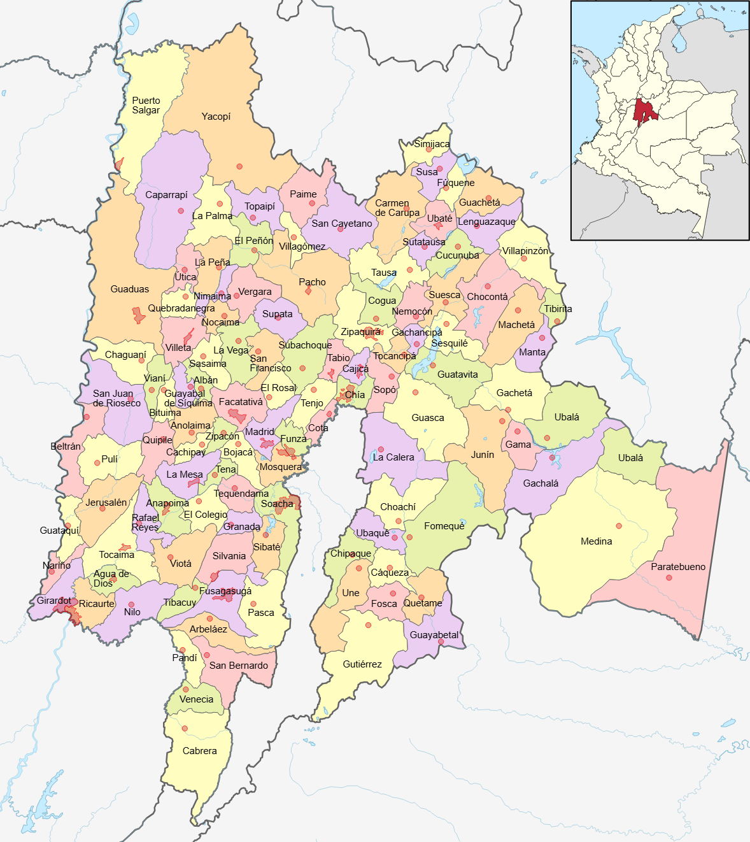
Objective
To identify the most suitable areas for living in the department of Cundinamarca through a spatial multi-criteria analysis (SMCA), integrating environmental factors, infrastructure and regulatory restrictions

Slide 3
Data
Vector and raster layers are used to represent:
Physical conditions: elevation (DEM), slope, average temperature.
Infrastructure and services: Water and sewage coverage, road network, population centers, municipal categories.
Legal restrictions: Protected areas (RUNAP), mining titles, indigenous reserves, land use coverage (e.g. water bodies).
All data are reprojected and cropped to the Cundinamarca area to ensure spatial consistency

Slide 4
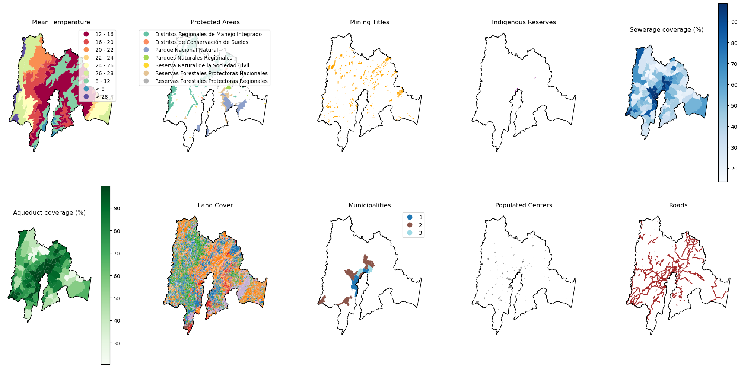
Data

Slide 5
Methodology
1. Data Processing
3. Constraints
Vector: Filtering and cropping according to relevant criteria
Rasterization: Vector layers are converted to raster aligned to the reference DEM.
A combined mask is created to exclude unsuitable areas (protected, mining, indigenous, water bodies).
Results
Weight matrices are defined for different scenarios (equal importance, priority in accessibility, services, nature).
Suitability is calculated as a weighted combination of the normalized factors.
Restrictions are applied, excluding unsuitable areas.
The most suitable zones are concentrated in flat areas, close to infrastructure and services, mainly in the center and west of Cundinamarca.-
Legal and environmental restrictions exclude large areas, especially in mountainous and protected areas.
Euclidean distance layers to roads, population centers and natural areas are generated.
All factors are normalized to a common scale (0-10) using
2. Factor calculations
4. Multicriteria analysis

Slide 6
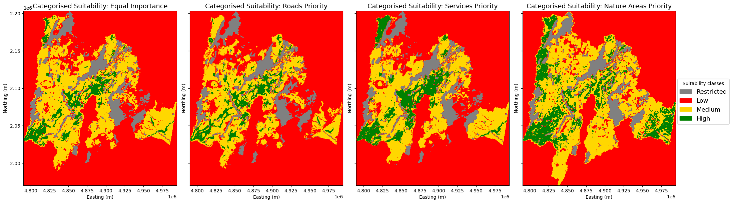
Results

Slide 7
Thanks

